Slide 1

DEEP NEURAL NETWORK MODULE # 3 : LINEAR NEURAL NETWORKS FOR REGRESSION
DNN Team
BITS Pilani WILP

Slide 2
The instructor is gratefully acknowledging the authors who made their course materials freely available online.
This deck is prepared by Seetha Parameswaran.
Deep Learning

Slide 3








Table of Contents
Regression
Linear Regression
The Linear Model: Single Neuron
Worked Example
Evaluation
Python Implementation Implementation Tips
Summary
1
2
3
4
5
6
7
8
Deep Learning

Slide 4
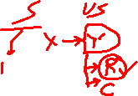
What is Regression?
Definition
Regression is a supervised learning task that predicts a continuous-valued output based on input features.
Key Characteristics:
Input: Feature vector x ∈ R^{d}
Output: Real-valued target y ∈ R
Goal: Learn a function f : R^{d} → R such that y ≈ f (x)
Deep Learning

Slide 5
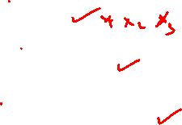
Examples of Regression Problems
House Price Prediction
Input: Size, location, number of rooms
Output: Price in dollars
Temperature Forecasting
Input: Historical weather data, season, humidity
Output: Temperature in degrees
Stock Price Prediction
Input: Historical prices, trading volume, market indicators
Output: Future stock price
1
2
3
Deep Learning

Slide 6


Table of Contents
Regression
Linear Regression
The Linear Model: Single Neuron
Worked Example
Evaluation
Python Implementation Implementation Tips
Summary
1
2
3
4
5
6
7
8
Deep Learning

Slide 7

What is Linear Regression?
Definition
Linear regression assumes the output is a linear combination of the input features.
Mathematical Form:
y = w₀ + w₁x₁ + w₂x₂ + · · · + w_{d}x_{d}
(1)
where:
x = [x₁, x₂, . . . , x_{d} ]^{T} are the input features
w = [w₁, w₂, . . . , w_{d} ]^{T} are the weights
w₀ is the bias term
Deep Learning

Slide 8

Examples of Linear Regression
1
Salary Prediction
Salary = w₀ + w₁ × Years of Experience
2
Crop Yield Prediction
Yield = w₀ + w₁ × Rainfall + w₂ × Fertilizer
3
Energy Consumption
Energy = w₀ + w₁ × Temperature + w₂ × Hour + w₃ × Day
The relationship between inputs and output is assumed to be linear.
Deep Learning

Slide 9
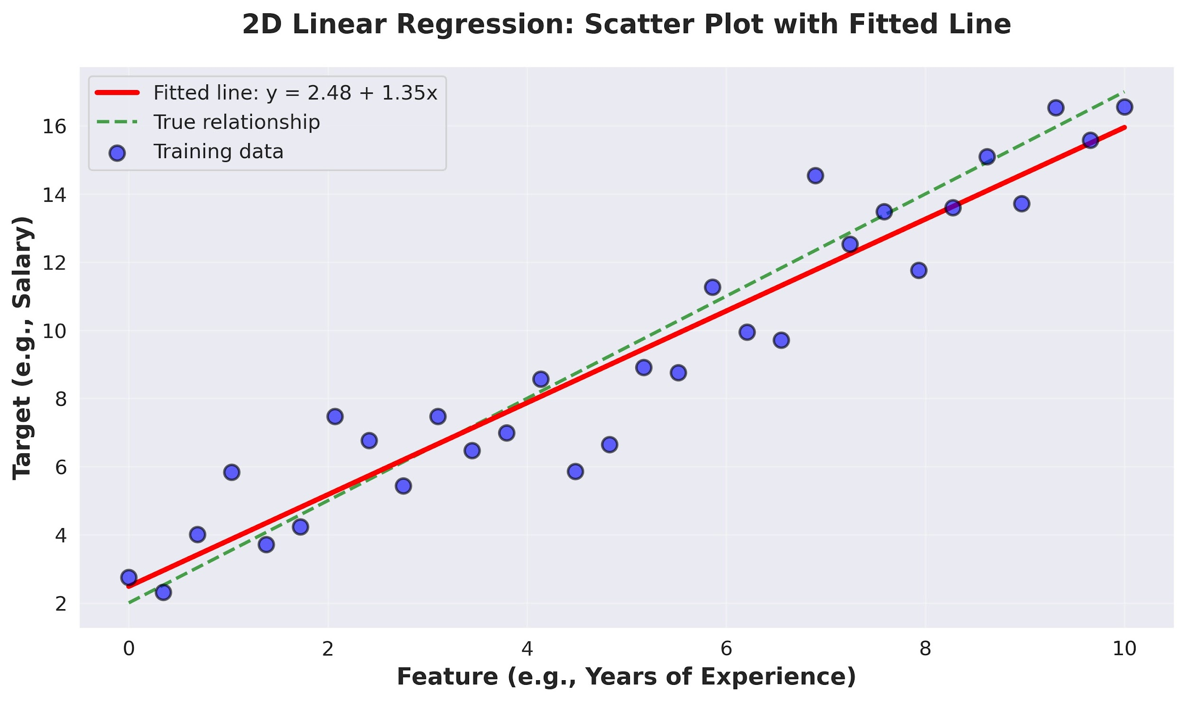
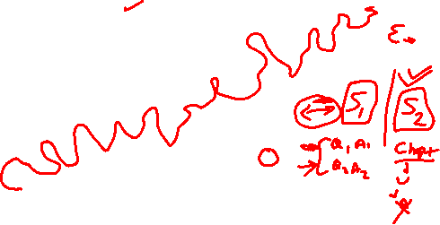
Visual Example: 2D Linear Regression
Deep Learning

Slide 10

Table of Contents
Regression
Linear Regression
The Linear Model: Single Neuron
Worked Example
Evaluation
Python Implementation Implementation Tips
Summary
1
2
3
4
5
6
7
8
Deep Learning

Slide 11
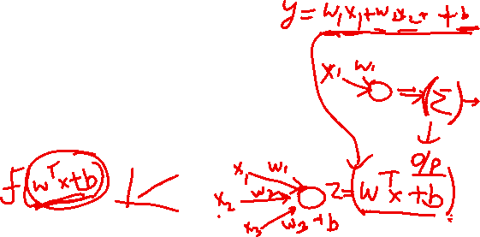
The Four Components
A complete machine learning system consists of:
1
Data: d -dimensional input vectors and target outputs Model: Single neuron implementing linear function Objective Function: Measures prediction error
Learning Algorithm: Gradient descent to optimize weights
2
3
4
Deep Learning

Slide 12
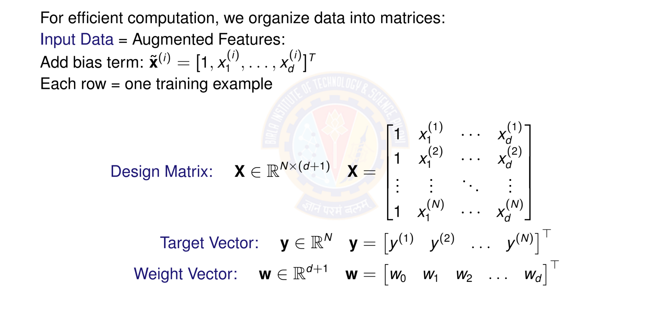
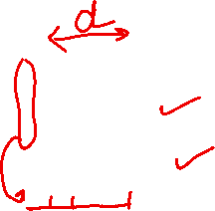
Matrix Form of Data
Deep Learning

Slide 13

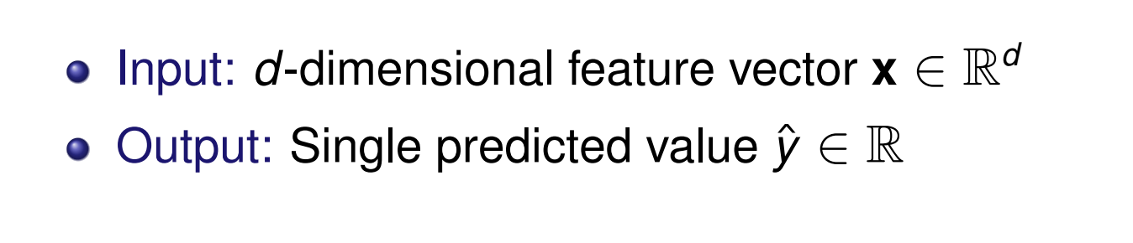

Linear Model as a Single Neuron
Model linear regression as a single artificial neuron:
1
x₁
w₀ w₁ w₂
f
Σ
y^{ˆ}
x
2
.
x_{d}
.
w_{d}
Deep Learning

Slide 14
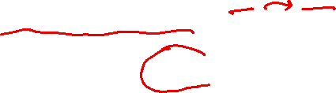
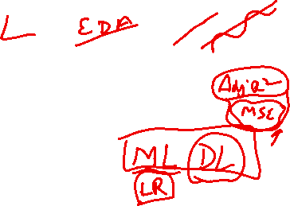
Linear Model Prediction
Model: A single neuron computes a weighted sum and applied identity activation function.
Prediction for input x:
y^{ˆ} = f (w^{T} x) = f (w₀ + w₁x₁ + w₂x₂ + · · · + w_{d} x_{d} )
(2)
where:
w = [w₀, w₁, . . . , w_{d} ]^{T} ∈ R^{d +1} are the model parameters
x = [1, x₁, . . . , x_{d} ]^{T} ∈ R^{d +1} is the input
f (·) is the identity activation f (z) = z
Vectorized form: for all predictions
y^{ˆ} = Xw
(3)
Deep Learning

Slide 15
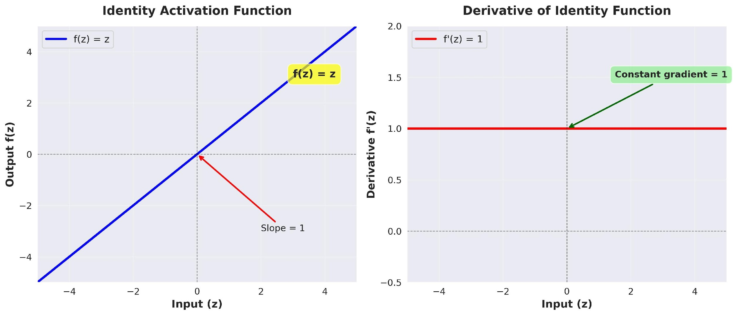

Identity Activation Function
Identity Activation Function
f (z) = z
(4)
Deep Learning

Slide 16
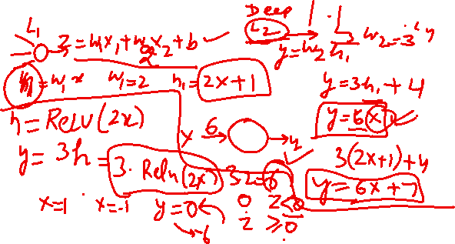

Slide 17
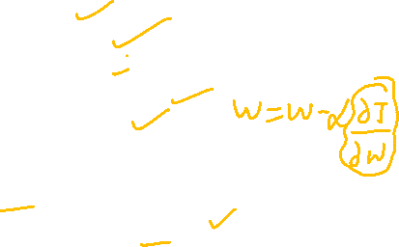
Identity Activation Function
Properties of Identity Function Output: Continuous, (−∞, ∞)
Differentiable everywhere: f '(z) = 1 Allows output to take any real value
Gradient flows unchanged through the neuron Perfect for predicting continuous targets
Why identity for regression?
Target values are continuous (prices, temperatures, etc.) Need to predict any real number, not just binary { 0,1 } Differentiability enables gradient-based optimization
No information loss from input to output
Deep Learning

Slide 18
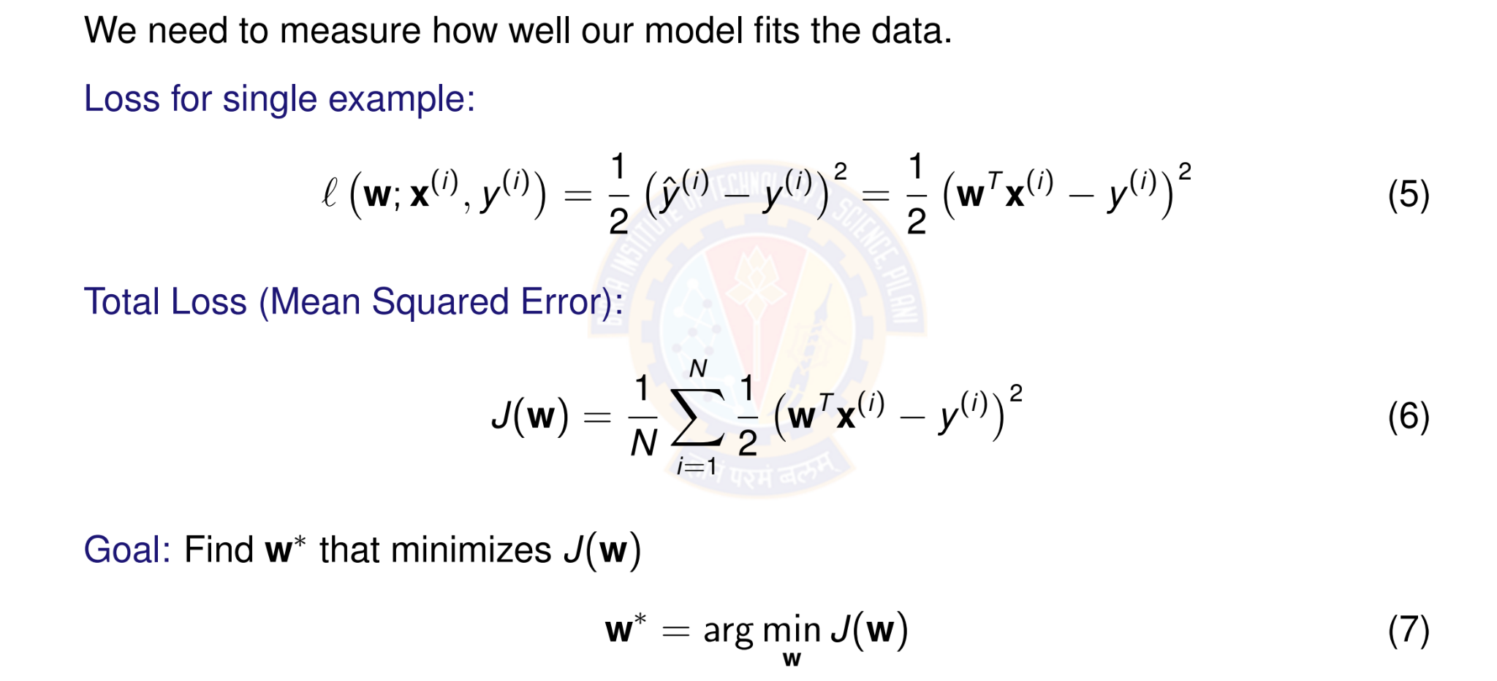
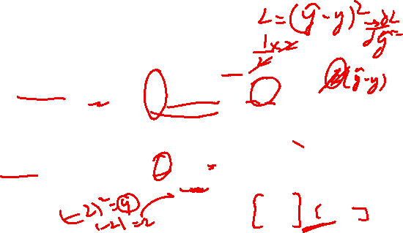
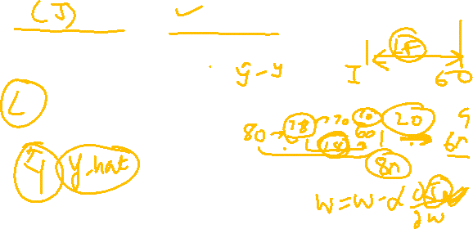
Objective Function: Squared Error Loss
Deep Learning

Slide 19
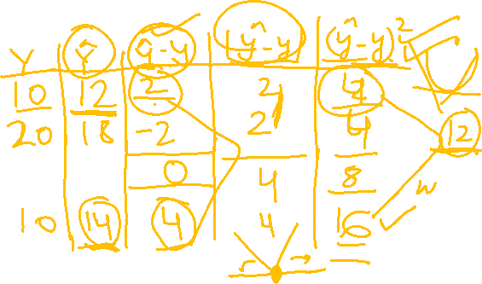

Slide 20
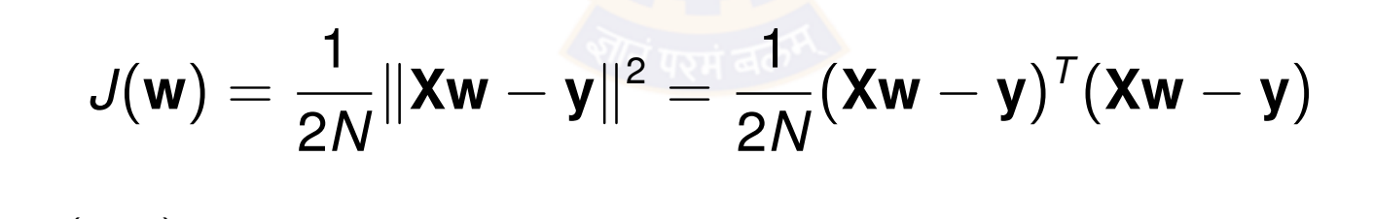

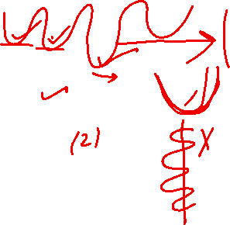
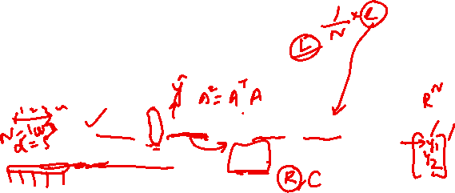
Why Squared Error?
Advantages of squared error loss:
Differentiable: Smooth everywhere, easy to optimize Convex: Single global minimum (for linear models) Penalizes large errors: Quadratic growth
Statistical interpretation: Maximum likelihood under Gaussian noise
Vector Form:
(8)
where X ∈ R^{N×(d +1)} is the design matrix and y ∈ R^{N} is the target vector.
Deep Learning
Notes:
The squared error loss, commonly known as Mean Squared Error (MSE), is a widely used objective function in neural networks, particularly for regression tasks where the goal is to predict continuous numerical values.
Definition and Calculation:
The MSE loss quantifies the average of the squared differences between the predicted output of the neural network and the true, or actual, target values.
Differentiable: This allows for the efficient calculation of gradients needed to update the network's parameters.
Convexity: FFor a given set of 𝑁 data points, where yi represents the true value and ${\hat{y}}_{i}$ represents the predicted value for the 𝑖-th data point
or many simpler models, MSE can be a convex function, meaning there is a single global minimum that optimization algorithms can reliably find.
Smoothness: Its smooth nature facilitates the optimization process.

Slide 21
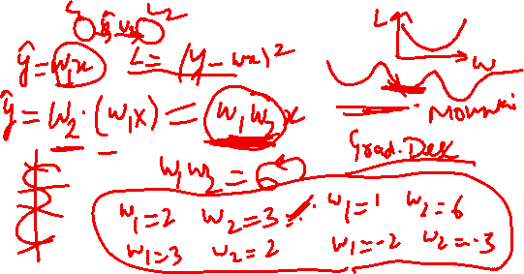

Slide 22
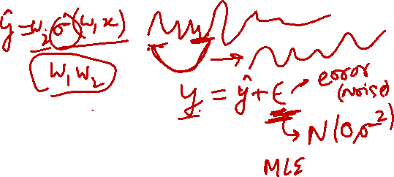

Slide 23
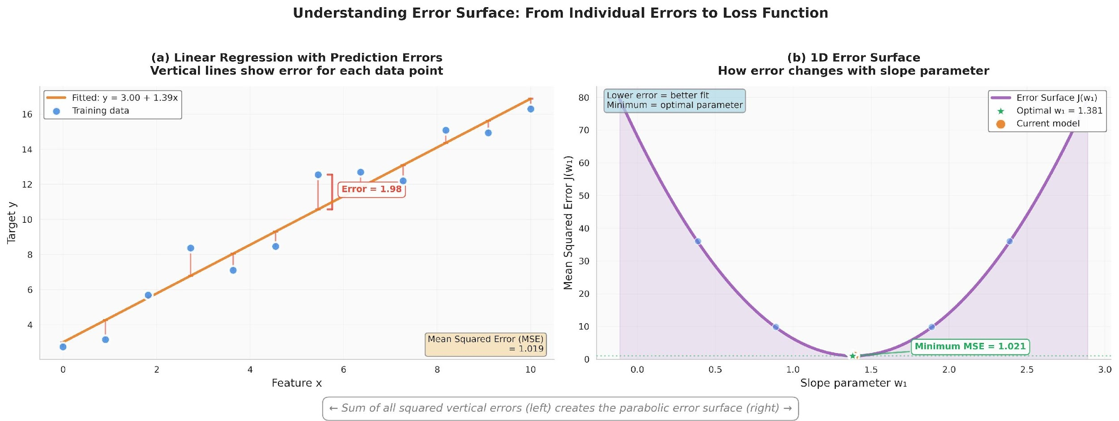
Visualizing the Error Surface
The error surface is convex with a single global minimum.
Deep Learning
Notes:
Part (a) Linear Regression with Prediction Errors: This graph displays training data points and a fitted line representing a linear model.
The vertical lines represent the error (or residual) for each data point, which is the difference between the actual target value and the value predicted by the model.
The goal of linear regression is to minimize these errors.
Part (b) 1D Error Surface: This graph shows how the Mean Squared Error (MSE) changes as a single model parameter (the slope, $w$) is adjusted.
The MSE is calculated by summing the squares of all the individual errors from the left graph.
The resulting curve is parabolic, known as the error or cost surface.
The lowest point of this curve (the minimum MSE) corresponds to the optimal parameter value (optimal $w$) that provides the best fit line for the data.
Finding this minimum is the objective of optimization algorithms like gradient descent.

Slide 24
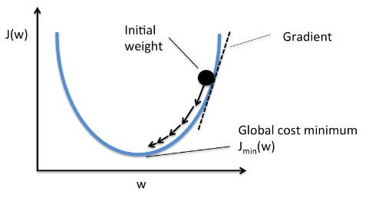
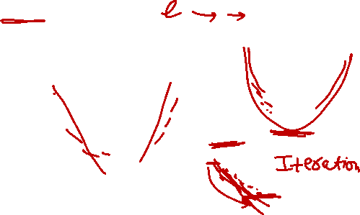
Gradient Descent Algorithm
Idea: Iteratively update weights in the direction of steepest descent
where η > 0 is the learning rate (step size).
Intuition: Move downhill on the error surface to find the minimum.
Deep Learning
Notes:
Cost Function: The curve represents the cost function, labeled $J\left(w\right)$on the vertical axis. This function measures the "cost" or error of the model's predictions based on a given weight parameter 'w' on the horizontal axis.
Objective: The goal of the algorithm is to find the parameter 'w' that minimizes the cost function, reaching the "Global cost minimum", $J_{min}\left(w\right)$ .
Initial Point: The process begins at an "Initial weight" (the black dot), a randomly chosen starting point on the cost function curve.
Gradient and Iteration: The "Gradient" (dashed line) represents the slope of the tangent at the current point. The algorithm iteratively updates the weight by moving in the direction opposite to the gradient (down the slope), as indicated by the arrows. This process is repeated until the minimum is reached, effectively minimizing the model's error. The update rule is typically $w=w−η⋅∇J\left(w\right)$, where $η$is the learning rate and $∇J\left(w\right)$ is the gradient.

Slide 25
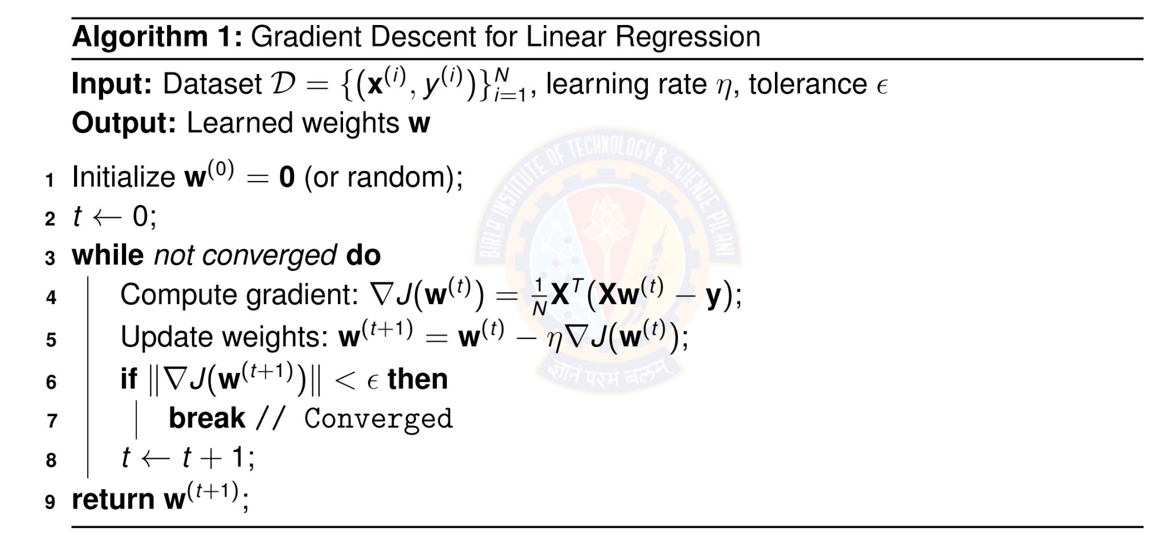
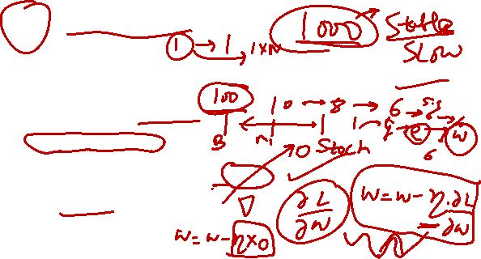
Batch Gradient Descent Algorithm
Deep Learning

Slide 26
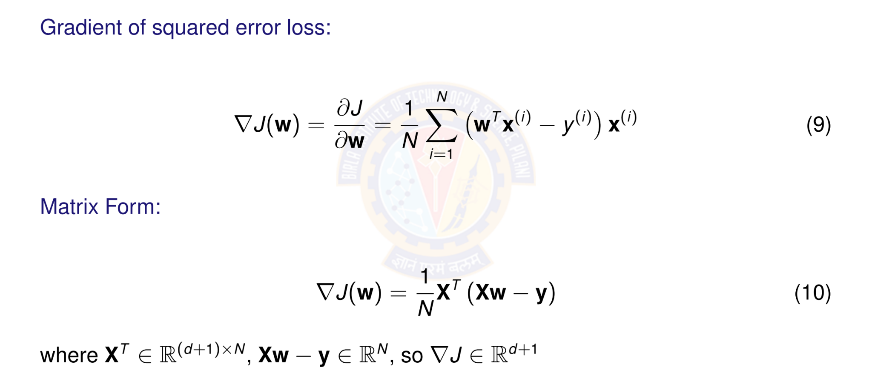
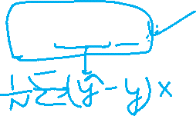
Computing the Gradient
Deep Learning
Notes:
In a neural network, the gradient is a vector that represents the direction and magnitude of the steepest ascent of the loss function. It is calculated using the partial derivatives of the loss function with respect to each of the network's parameters (weights and biases). During training, this information is used to guide the process of gradient descent, which adjusts the parameters in the opposite direction of the gradient to minimize the loss and improve the model's predictions

Slide 27
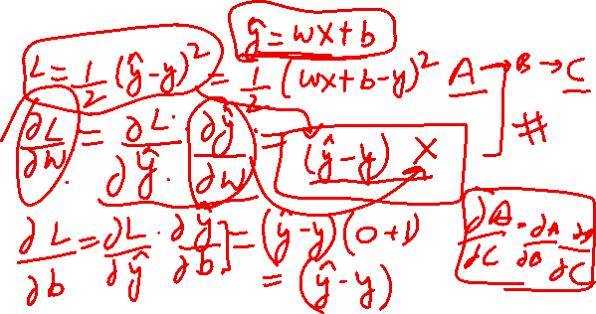

Slide 28
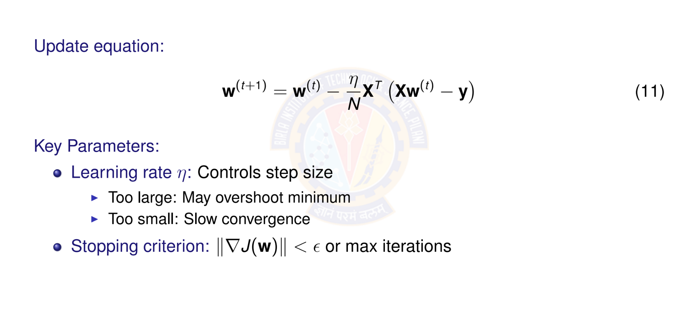
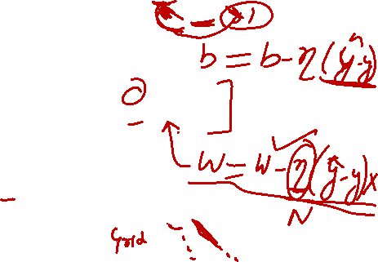
Gradient Descent Update Rule
Deep Learning
Notes:
This formula represents a step in the direction opposite to the gradient of a cost function, scaled by a learning rate $η$
Learning rate ($η$): This parameter controls the step size taken during each update. If too large, the algorithm may overshoot the minimum of the cost function.
If too small, the convergence to the minimum will be slow.
Stopping criterion: This condition determines when the optimization process should stop. The process terminates when: The norm of the gradient of the cost function, is less than a small value $ε$.
A maximum number of iterations has been reached.

Slide 29

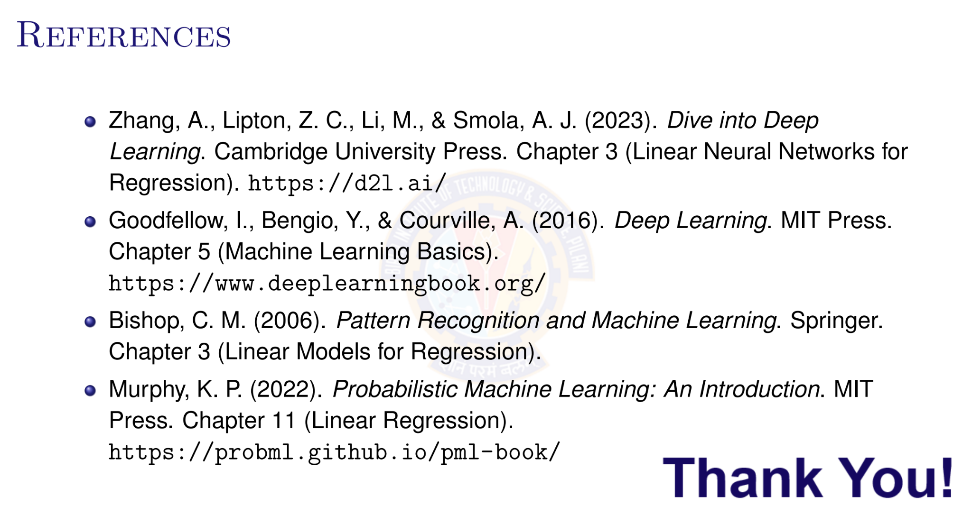
Deep Learning

